Slide 1



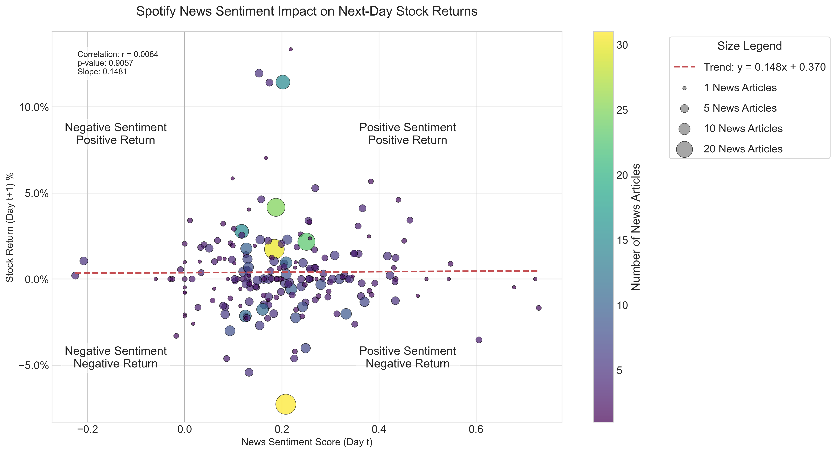
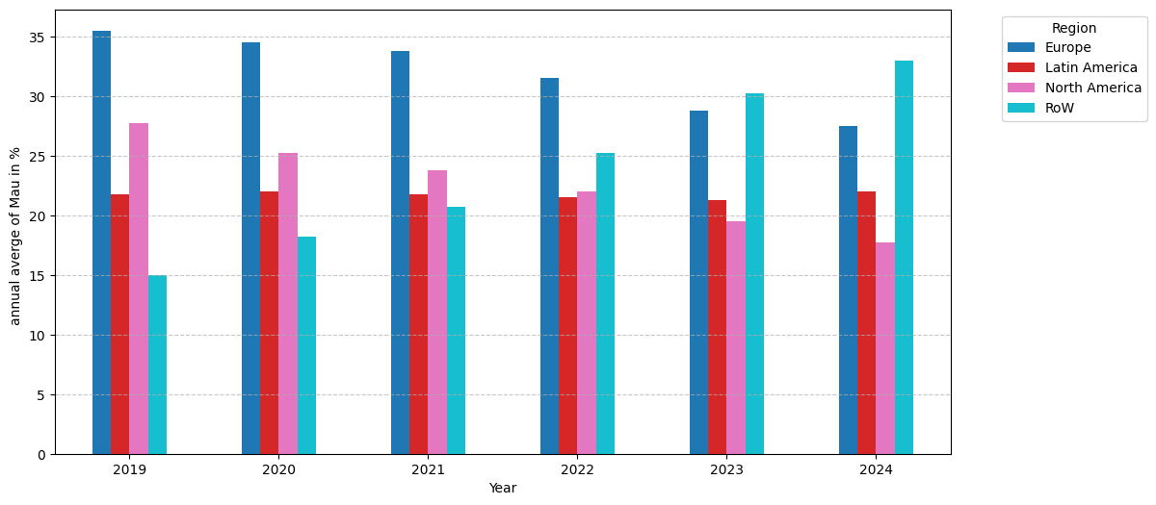


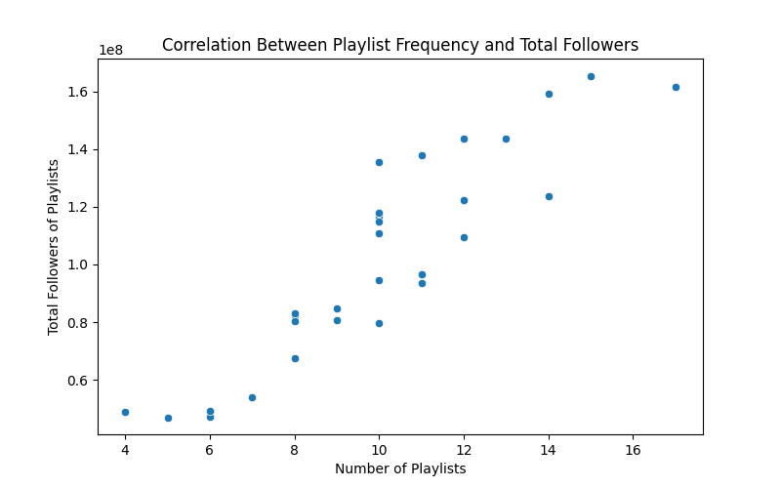
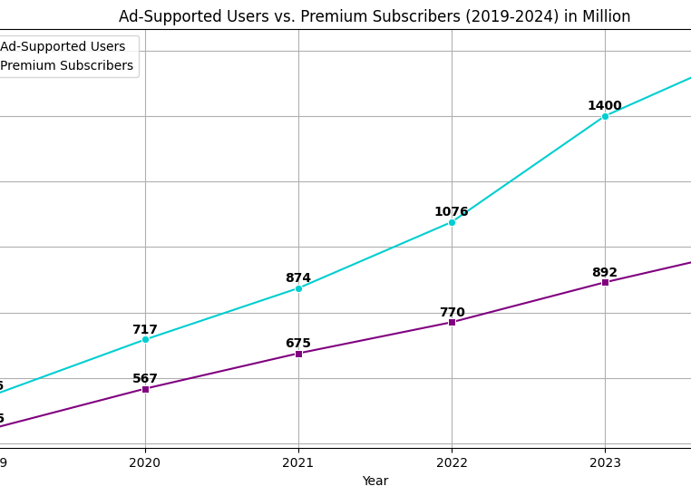



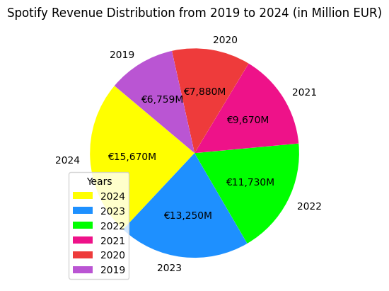
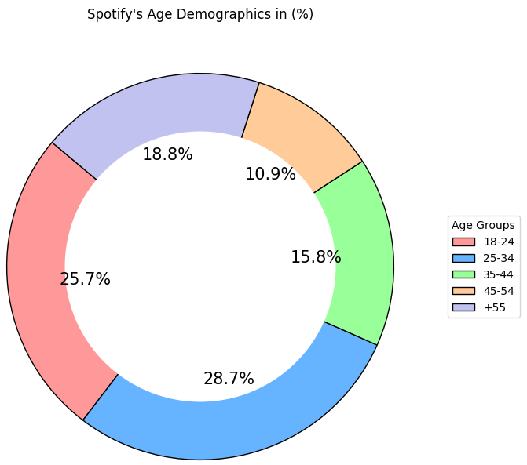



Spotify’s User Base: Stats, Growth & Trends Kira Schwarz, Sahand Hamed, Anahita Mesgarzadeh Tehrani, Armando Criscuolo
Introduction
Spotify is a leading global music streaming platform with millions of monthly active users. This analysis examines the platform’s user growth over time, the impact of economic factors, and regional usage trends. Furthermore, it explores the balance between free and premium subscribers and the effects of pricing changes. Additionally, the study investigates trends in Spotify’s music charts to provide deeper insights into user behavior.
Method
Research Questions:
Filter & Clean
Data Visualization:
Suitable for a DS-Project
Sources:
Acceptable & publicly available
Data:
Fitting & various diagrams
Finalize Questions
Look Sources
Gather Data
Filter Data
Clean Data
Visualize Data
Challenges
Sentiment Analysis
Global Regions
The scatter plot shows virtually no correlation (r = 0.0084, p-value = 0.9057) between Spotify news sentiment scores and next-day stock returns, with data points distributed across all four sentiment-return quadrants regardless of article volume (indicated by point size). This suggests that media coverage sentiment has negligible predictive power for Spotify's short-term stock performance
The bar chart shows the distribution of users across different regions over the years, representing the annual average of monthly active users (MAU) in percentage for each region.
Tendency of Tracks
Ratio for Spotify’s Plans & Revenue
The chart illustrates the growth of ad-supported users and premium subscribers from 2019 to 2024, measured in millions. While both categories show a steady increase, ad-supported users grow more rapidly, reaching 1608 million in 2024, compared to 1000 million premium subscribers.
This scatter plot illustrates a clear positive correlation: tracks that appear in more playlists tend to reach a higher total number of followers.
Age Groups
The pie chart combines ad-supported and premium revenues to show the overall revenue trends from 2019 to 2024.
The donut chart illustrates the percentage distribution of Spotify users across various age groups. The largest user segments are individuals aged 25-34 (28.7%) and 18-24 (25.7%), followed by smaller proportions in older age groups.
Sources
Spotify – Financials
Spotify Charts - Spotify Charts are made by fans
Web API | Spotify for Developers
Spotify Stats | Users, Revenue & Demographics 2025 | Priori Data
AnahitaTehrani/Data-Science-Project

